Slide 1
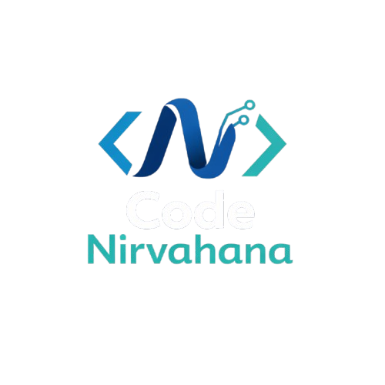
Orientation Session
AIML Series - Vedha

Slide 2
Why AI/ML Veda?
AI is transforming every industry.
Most online courses are incomplete or expensive.
Many students don't know where to start.
This series gives a complete roadmap for free.

Slide 3
FOLLOW OF VEDHA SERIES
Basics
ML Concepts
DL Concepts
AI Concepts
Mini Projects
Full Stack Project

Slide 4
CONCEPTS IN VEDHA
Python & it’s library
Mathematics
Database
ML Part-1
ML Part-2
ML part-3
DL
AI
DevOOP’s

Slide 5
What You'll Get
Complete Notes
Practice Problems
Assignments
Source Code Project Files
Revision Material

Slide 6
Your Participation (The Only Fee)
Watch the session.
Take a screenshot while attending.
Post it on LinkedIn.
Share your learning.
Tag:
Your LinkedIn Profile
Code Nirvana LinkedIn Page

Slide 7
Community Guidelines
Please:
Be consistent.
Complete assignments.
Ask doubts respectfully.
Help fellow learners.
Avoid negativity.
Stay disciplined.

Slide 8
What Happens After Completing This Series?
By the end of the series, you will be able to:
Understand AI fundamentals.
Build ML models.
Build Deep Learning applications.
Work with LLMs.
Build AI projects.
Create a strong portfolio.
Prepare for placements.
Prepare for internships.
Start freelancing.
Begin AI research.

Slide 9
Stay Connected
Include:
YouTube Channel
LinkedIn
Instagram (if available)
Telegram/Discord/WhatsApp Community (if available)
GitHub (if available)

Slide 10
THANK YOU
T

